Slide 1
Imaging: Forensic Acquisition of Digital Evidence

Slide 2
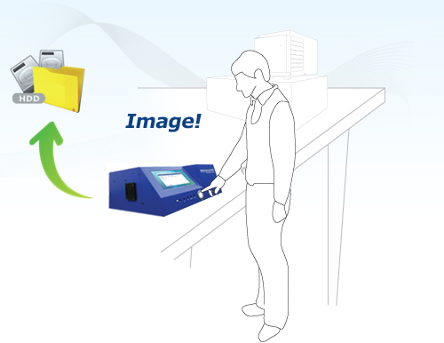
Objective
By the end of this module, participants will be able to create a forensically sound image of digital media consistent with industry best practices
Notes:
Properly seize, it includes documentation, bag and tag, chain of custody.

Slide 3
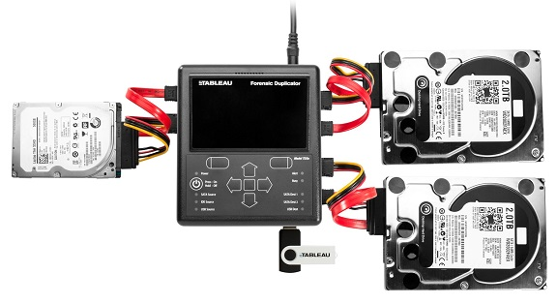
Digital Forensic Process
Imaging is the second phase and requires forensically-sound procedures and validated tools
Identification
Acquisition/
Imaging
Analysis
Reporting
Court Presentation

Slide 4



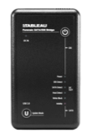
Digital Forensic Image Acquisition
Forensic image is:
A verifiable duplicate of all the contents of a storage media or selected files in a form of encapsulated file.
Acquired by trained digital forensic examiner using validated hardware and software tools
Image File
Write Blocker
Evidence Drive

Slide 5
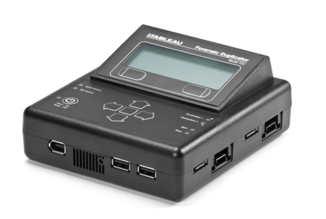
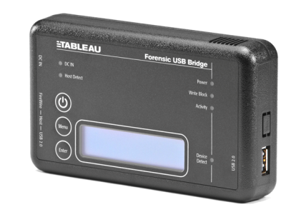
Hardware-based Imaging Tools
Write blocker (physical bridge)
Stand-alone imaging device (multifunction tool with dedicated forensic capabilities)
Notes:
Protecting data integrity is the top priority!

Slide 6


Software-based Imaging Tools
Write-blocker: Specialized application
Forensic Imager: Multi-function tools that assist with hard drive preparation and duplication, forensic imaging, and verification
Notes:
Protecting data integrity is the top priority!

Slide 7
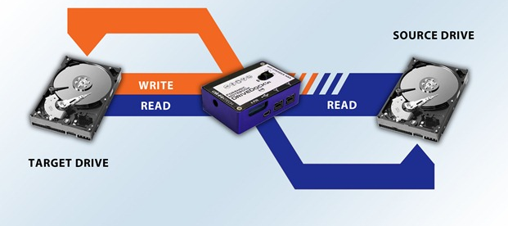
Imaging Tools Concept
Notes:
Protecting data integrity is the top priority!

Slide 8
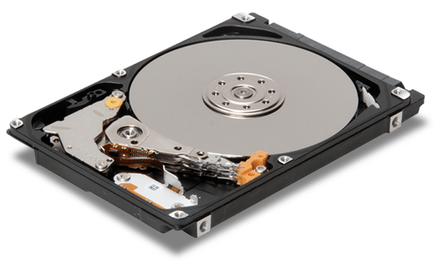
Imaging a Hard Disk Drive
Sector[A]
Sector[X]
Sector[0]
C:\
E:\
Sector[Z]
Sector[B]
Sector[Y]
Partition Boundary
Notes:
Protecting data integrity is the top priority!

Slide 9
You can also split your content
Sector [0] → Sector [Z]
Sector [A] → Sector [B]
Physical image:
A forensic copy of every addressable sector from source media
Logical image:
A forensic copy of every addressable sector between two partition boundaries

Slide 10


Verification of Forensic Image
Hash:
Is a mathematical algorithm
Produces a unique digital fingerprint
Verifies that binary content of an acquired forensic image is exactly the same as the source media
MD5 = ABC123
MD5 = ABC123
Notes:
Protecting data integrity is the top priority!

Slide 11

Preparation of Destination Storage Media
Verify size requirements of original evidence
Select storage media that meets or exceeds capacity of source
Sterilize destination media
Format storage media
Notes:
Protecting data integrity is the top priority!

Slide 12
Summary
Forensic Imaging of digital evidence is one of the important phase of digital forensic process to preserve and ensure the integrity of the evidence
Digital forensic examiner must follow established forensic procedures when acquiring digital evidence from source media
Notes:
Protecting data integrity is the top priority!

Slide 13
Thanks!
Any questions?

